Slide 1
Systemiq perspectives on the
Global Resources Outlook 2024
17th April 2024

Slide 2
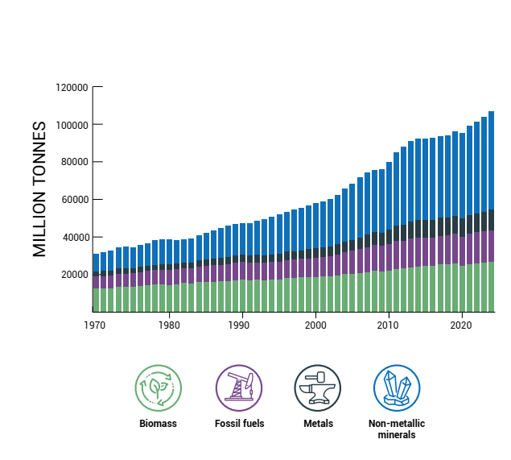
Resource use is rising (almost) faster than ever, while productivity stagnates
Source: International Resource Panel (2024), Global Resources Outlook 2024 (https://www.resourcepanel.org/reports/global-resources-outlook-2024)

Slide 3
Meanwhile, other productivities soar…
Labour
GHG
Index, 1970 = 1
Energy
Materials
Source: International Resource Panel (2024), Global Resources Outlook 2024 (https://www.resourcepanel.org/reports/global-resources-outlook-2024)

Slide 4
High-income countries use six times more materials per capita than low-income countries…
Material footprint (total and per capita) by income group
Tonnes per capita
Million tonnes
27
24
19
13
9
9
3
4
3
5
Low income
Lower
middle
income
Upper
middle
income
High
income
World
2000
2020
Per capita
Source: International Resource Panel (2024), Global Resources Outlook 2024 (https://www.resourcepanel.org/reports/global-resources-outlook-2024)

Slide 5
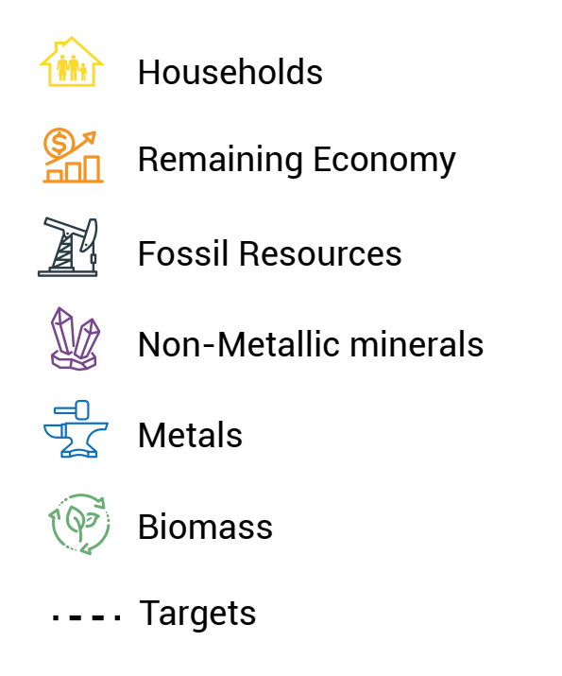
…And it’s driving climate change, biodiversity loss, pollution and more
Environmental impacts of materials in the value chain in extraction and processing phase
Global share in 2022 (%)
Climate impacts (method GRO 2019)
Climate impacts
(inc
land use change)
PM health impacts
Water
stress
Biodiversity
loss
(land)
Biodiversity
loss (freshwater eutrophicat.)
Value
added
Workforce
60% of global climate change impacts including land use change
40% of air pollution health impacts
  Climate change
Pollution
Water
Biodiversity loss
Economic Impacts
> 90% of water stress and global land and water eutrophication related biodiversity loss
Sector grouping
Biomass
Fossil resources
Metals
Remaining economy
Non-metallic minerals
Households
Source: International Resource Panel (2024), Global Resources Outlook 2024 (https://www.resourcepanel.org/reports/global-resources-outlook-2024)

Slide 6
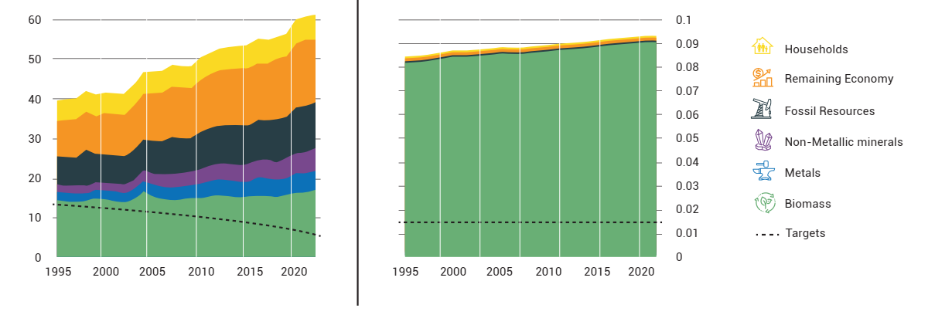
Impacts are increasing, and massively exceed globally agreed targets
Climate impact
Biodiversity impact
Climate impacts (Gt CO₂ –eq)
Land-related biodiversity loss (global pdf*)
** Global pdf: Global potentially disappeared fraction of species
Source: International Resource Panel (2024), Global Resources Outlook 2024 (https://www.resourcepanel.org/reports/global-resources-outlook-2024)

Slide 7



Resources should be targeted to human needs through provisioning systems
Human needs
Provisioning systems
Natural resources
Adequate, nutritious food for all
Safe, secure, resource-efficient built environment
Sustainable mobility and access to essential services
Access to clean, safe energy
Nutrition
Built
environment
Biomass
Fossil fuels
Metals ores
Mobility
Energy
Non-metallic minerals
Land
Water

Slide 8
Major provisioning systems have different material footprint breakdowns: nutrition mainly biomass, household energy mainly fossil fuels
Material footprint by provisioning system and material type (2022)
Global material footprint (Billion tonnes)
23.5
28.6
30.6
6.1
17.2
100%
100%
100%
100%
4%
Remaining provisioning systems
(clothing; water and sanitation; education; other (appliances, communication devices))
Biomass
Fossil fuels
Metal ores
1%
Non-metallic minerals
Food and nutrition
Mobility
Built environment
Household energy
(All provisioning systems include material footprints of energy embodied along their value chains; household energy solely represents energy directly used by consumers)
Source: International Resource Panel, Global Resources Outlook 2024 (https://www.resourcepanel.org/reports/global-resources-outlook-2024)

Slide 9
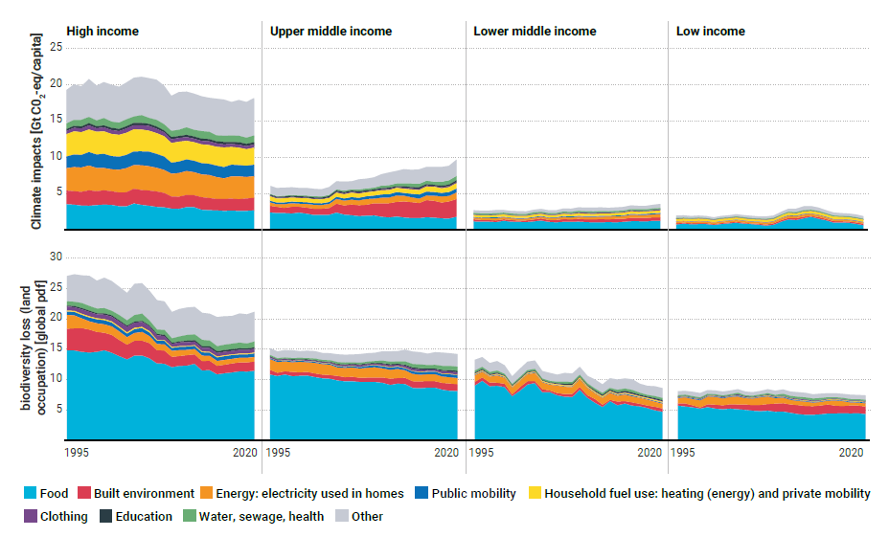
High-income countries drive ten times ten times more climate impacts per capita than low-income countries
*
* Global pdf: Global potentially disappeared fraction of species

Slide 10
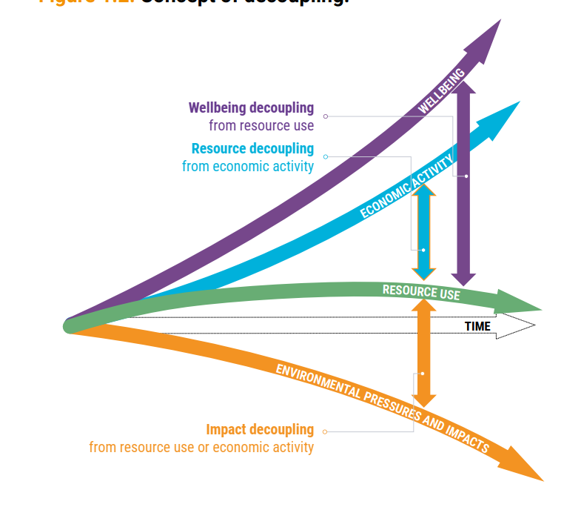
The solution: decoupling resource use from economic activity and human wellbeing
Source: International Resource Panel (2024), Global Resources Outlook 2024 (https://www.resourcepanel.org/reports/global-resources-outlook-2024)

Slide 11
Sustainability Transition Scenario is built up as three ‘shifts’ plus measures to support just transition, and measures to optimise key provisioning systems
Multi-model framework with provisioning system lens
Resource Efficiency
BUILT ENVIRONMENT shelter & mobility
Sustainable Consumption
and Production (SCP)
ENERGY SYSTEM
(includes transport)
Climate and Energy
Food and Land
FOOD SYSTEM
agriculture & land use
Just Transition
Source: International Resource Panel (2024), Global Resources Outlook 2024 (https://www.resourcepanel.org/reports/global-resources-outlook-2024)

Slide 12
It is possible to mitigate future resource use while growing the economy, improving well-being and dramatically reducing environmental impacts
2060 outcomes from Sustainability Transition scenario, compared to continued Historical Trends:
Growing Economy
:
+ 3%
Reduced inequality
:
Lower income group Material Footprint gap
Improved wellbeing
:
Higher HDI all income groups
Reduced growth in resource use
:
By 30%
Reduced environmental impacts
:
GHG emissions - 83%
Energy demand - 27%
Agricultural land area - 5%
Source: International Resource Panel (2024), Global Resources Outlook 2024 (https://www.resourcepanel.org/reports/global-resources-outlook-2024)

Slide 13
Bold policy action can make the Sustainability Transition Scenario real
Institutionalizing resource governance
and defining resource
use paths
Directing finance towards sustainable resource use
Making trade an engine of sustainable resource use
Mainstreaming sustainable consumption options
Creating circular, resource-efficient and low-impact solutions and business models
Global and national institutionalization of natural resource use within global sustainability agendas and action on environmental agreements
Definition of global and national resource use paths
Internalizing the environmental and social costs of resource extraction
Redirecting, repurposing and reforming public subsidies for sustainable resource
Channeling private finance towards sustain-able resource use
Incorporating resource-related risk into Public and Central Bank mandates
Trade governance for fairness and sustainable resource use
Enabling local resource value retention in producer countries
Developing action plans to improve access to sustainable goods and services
Regulating marketing practices leading to over- consumption, and raising awareness
Setting up monitoring systems to identify priorities and develop ambitious circular economy action plans
Developing and reinforcing regulation to boost circular economy business models
Building circular economy capacity and coalitions
Source: International Resource Panel (2024), Global Resources Outlook 2024 (https://www.resourcepanel.org/reports/global-resources-outlook-2024)

Slide 14
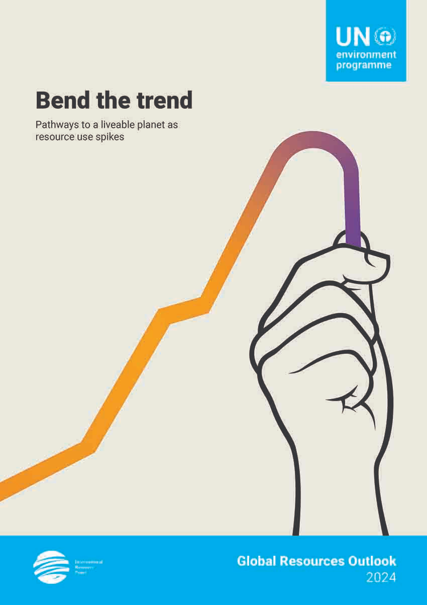

Global Resources Outlook 2024
Bend the trend
Pathways to a liveable planet as resource use spikes
Download the report
https://www.resourcepanel.org/reports/global-resources-outlook-2024
https://www.unep.org/resources/Global-Resource-Outlook-2024

Slide 15
Thanks for your attention!

